Slide 1
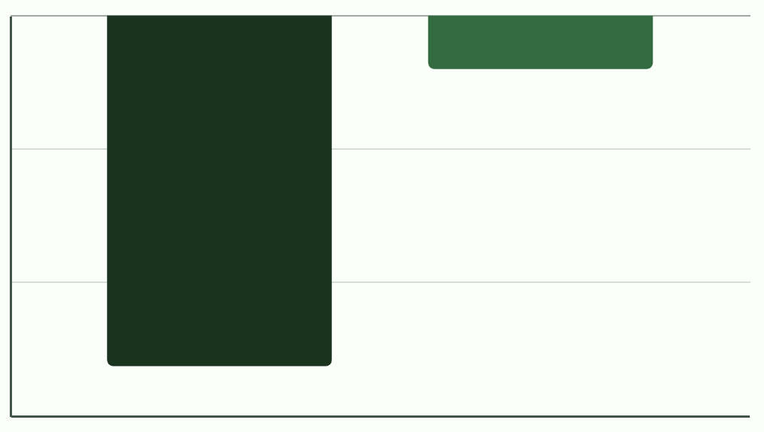
Hospital losses are driven by structural cost failures
$ 0
Key Takeaways
- $ 0.32 billion
High cost structures are the primary driver of over $2.1 billion dollars in system-wide losses.
The impact of low utilization is minor compared to the significant financial drain from elevated operating costs.
Profitable hospitals generate +16.3 billion dollars in net income, masking losses elsewhere in the system.
- $ 0.80 B
- $ 2.1 billion
- $ 1.60 B
- $ 2.40 B
High Cost Structures
Low Utilization

Slide 2

Losses Persist Due to Unfavorable Unit Economics, Not Utilization Gaps
Revenue Per Patient
$9,800
$6,800
Profitable Hospitals
Loss-Making Hospitals
Three thousand dollars less revenue per patient day
Cost Per Patient
$9,600
$8,400
Profitable Hospitals
Loss-Making Hospitals
Insight: Losses persist because loss making hospitals generate roughly three thousand dollars less revenue per patient day, even at high utilization.

Slide 3
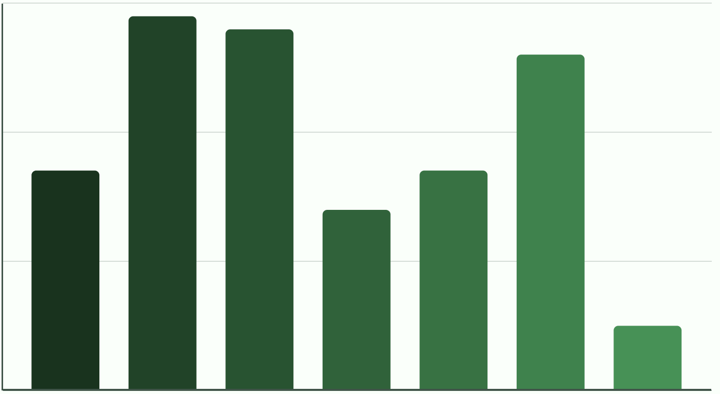
Losses Concentrate in Small and Mid-Sized Hospitals
Number of loss making hospitals by bed size category
30
20
Count of loss making hospitals
10
0
500+
0-49
50-99
100-149
150-199
200-299
300-499
Insight: Losses concentrate in small and mid-sized hospitals, making targeted interventions more effective than system-wide actions.

Slide 4
From Insight to Action: How Leadership Should Intervene and Monitor
Based on analysis of 438 hospitals and 2.1 billion dollars in system-wide losses
Where to Focus First
What to Fix
How to Track Progress
Loss-making hospitals with high cost structure
Bed size 50–299 beds
Primarily non-teaching and rural
Reset cost structure toward system median (~$7,000)
Close ~$3,000 revenue gap per patient
Rationalize underperforming service lines
Operating margin by hospital
Cost vs. system median
Revenue vs. system median
Utilization as secondary signal
Impact: 57 hospitals driving ~$2.1B in losses
Goal: Repeatable decision making and early intervention

